Slide 1

Ovarian Cancer Patients Who Have Received Multiple Prior Therapies:
When to Stop or Continue Treatment?
Eric Pujade-Lauraine, MD, PhD
Centre des Cancers de la Femme et Recherche Clinique
Centre Hospitalier Universitaire Hôtel-Dieu
Paris, France

Slide 2

What Does “Multiple Lines” Mean?
Multiple lines is at least 3 previous lines:
a minimum of 1 front-line (including maintenance) and 2 lines of chemotherapy. Thus, from the 4th line of therapy
In this setting, randomized trials are scarce, and prognostic factors relatively unknown

Slide 3
Lines of Chemotherapy Criteria in Resistant/Refractory Randomized Trials
Trial | Line
Canfosfamide vs PLD or topotecan¹ | 3rd
Patupilone vs PLD² | 2nd to 4th
Bevacizumab + Cx vs Cx (AURELIA)³ | 2nd to 3rd
Pertuzumab + Cx vs Cx⁴ | 2nd to 3rd
Lurbinectedin vs topo⁵ | 2nd to 3rd
4th line
= 6%
1. Vergote I, et al. Eur J Cancer. 2009;45(13):2324-2332; 2. Colombo N, et al. J Clin Oncol. 2012;30(31):3841-3847; 3. Pujade-Lauraine E, et al. J Clin Oncol. 2014;32(13):1302-1308; 4. AGO, on-going; 5. Poveda A, et al. J Clin Oncol. 2014;32(5S): Abstract 5505..

Slide 4
Multivariate Analysis of PFS at Each Relapse: An AGO-GINECO Analysis
PFS criteria, HR | 2nd line n = 1552 | 3rd line n = 829 | 4th line n = 414 | 5th line n = 178
Age | 1.01 | 1.01 | 1.00 | 1.00
ECOG 2 vs 0-1 | 1.15 | 1.27 | 0.78 | 1.00
FIGO IIIC-IV vs IB-IIIB | 1.26 | 1.41 | 1.24 | 0.92
Grade 2-3 vs 1 | 1.13 | 1.74 | 1.49 | 0.16
Histology muc vs sero | 0.98 | 1.21 | 1.08 | 3.04
Residue >0 vs 0 mm | 1.34 | 1.52 | 1.21 | 0.79
Platinum- Sensitive vs Resistant | 0.64* | 0.68* | 0.80 | 1.02
Hanker LC, et al. Ann Oncol. 2012;23(10);2605-2612.
* P<.05

Slide 5
Platinum-Free Interval (PFI) in 4th Line
PFI is <6 months in 33/40 pts (82%) having reached the 4th line of therapy
Even patients having progressed under the last chemotherapy regimen have still a small chance to achieve an objective response (n = 2/20, ORR = 10%)
Pujade-Lauraine E, unpublished

Slide 6
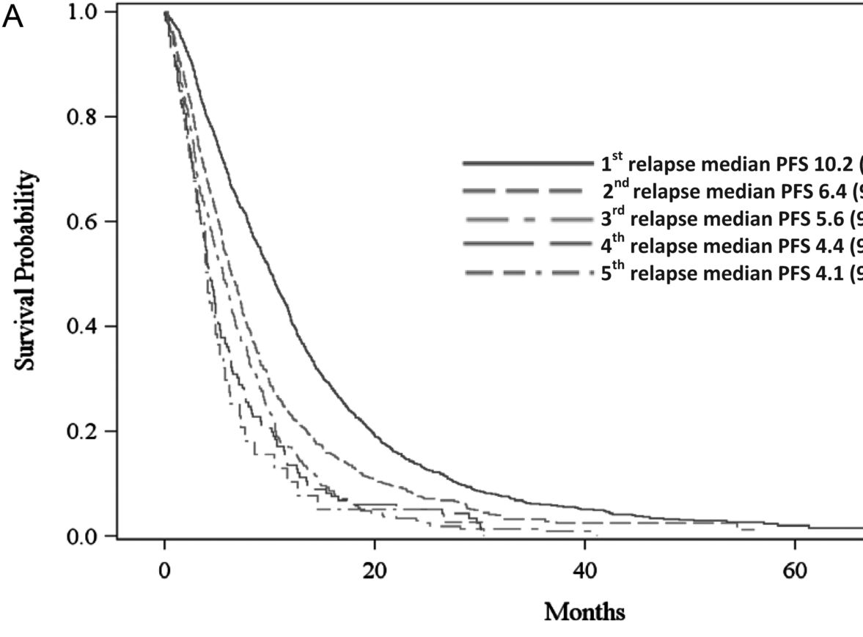
Outcome After Multiple Lines
Median PFS for Each Relapse
Hanker LC, et al. Ann Oncol. 2012;23(10);2605-2612.

Slide 7
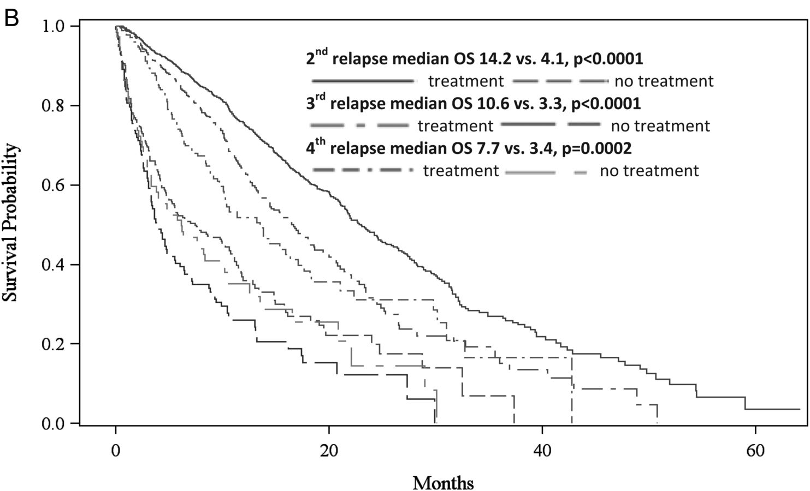
To Treat or Not to Treat The Disease ?
OS according to patients received treatment or not
Hanker LC, et al. Ann Oncol. 2012;23(10);2605-2612.

Slide 8
Treatment Outcome and Survival in Participants of Phase I Oncology Trials
n = 180 pts
Overall RR = 7.2%
Disease control rate = 48.2%
Italiano A, et al, Ann Oncol. 2008;19(4):787-792.

Slide 9
The Choice of Treatment:
The Armamentarium
Chemo single drugs approved: platinum, paclitaxel, PLD, gemcitabine, topotecan
Chemo combination: platinum (carboplatin) + paclitaxel, PLD, gemcitabine; trabectedin + PLD
Biologic therapy approved: bevacizumab, olaparib (BRCA+)

Slide 10
The Choice of Treatment:
The Armamentarium (cont)
Surgery
Hormonotherapy
Other active single drugs: cyclophosphamide, hexamethylmelamine, docetaxel, pemetrexed, etoposide, etc…
Other biologic therapy: trastuzumab (HER2), everolimus (m-TOR pathway), vemurafenib (BRAF), anti-MEK (ERK/MEK pathway)

Slide 11

If You Are Fond of Aphorisms!
Don’t hurry to treat when CA125 level increases

Slide 12
A drug that has failed has a low chance to succeed
Except PACLITAXEL!
One of the best drugs for q3 wk paclitaxel-resistant disease is weekly paclitaxel

Slide 13

When platinum-free interval is over 6 months, try platinum again
3 mos
6 mos
CARBOPLATIN-BASED Cx
SINGLE AGENT
CARBOPLATIN-BASED Cx

Slide 14
Choice Not to Treat the Disease
Poor response rate and outcome
Toxicity of anticancer treatments
  = palliative care is the best option

Slide 15
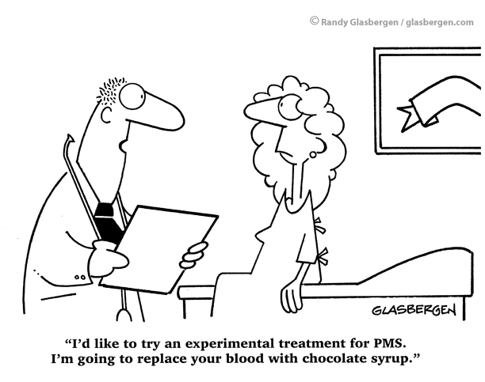
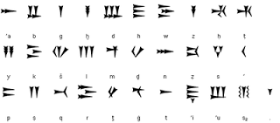
And what about MY life !!!
PFS
response
survival chance

Slide 16

Would you like to listen to ME!!! I need you
“What do you believe is the most effective in regards to informing you about the various possibilities of therapy available?”
1. A talk with the treating doctor 85%
2. Information offered on the internet 12%
Oskay-Özcelik g, et al. J Clin Oncol, 2013;31(Suppl): Abstract 5569.

Slide 17
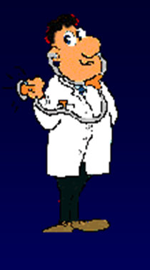
Listen to my hopes
I am hoping
1. Just for a less painful course of sickness 6%
2. For no recurrence of tumor-related symptoms 35%
3. To live longer than I otherwise would 24%
4. For complete healing without any
further complications 28%
Oskay-Özcelik G, et al. J Clin Oncol, 2013;31(Suppl): Abstract 5569.

Slide 18
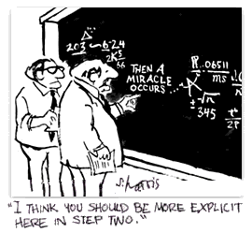

Slide 19
Olaparib Trial in Heavily
Pretreated Ovarian Cancer
n = 137 pts with measurable disease,
gBRCA+, and treated with at least 3 lines of prior therapy
Response rate: 34% (26-42) with a median response duration of 7.9 months
Conditional approval by FDA

Slide 20
Adjusting Hope With Reality
Disparity of expectation and perceived benefit from treatment is correlated with scores of depression
Sjoquist KM, et al. Oncologist. 2013;18(11):1221-1228.

Slide 21
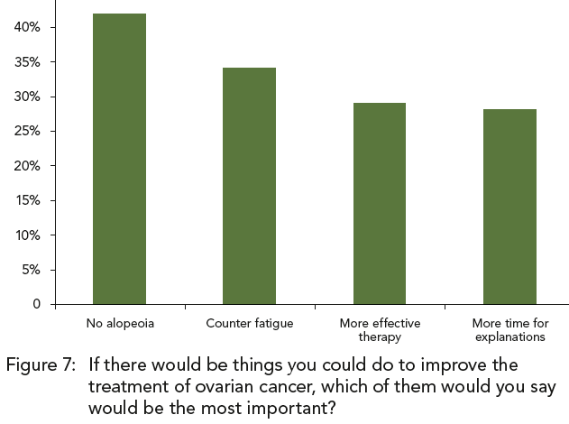
Listen to my desire
Oskay-Özcelik G, et al. J Clin Oncol, 2013;31(Suppl): Abstract 5569.

Slide 22
Listen to my pain and relieve me!
Symptom | Total (% pts) n = 364
Fatigue | 39.0
Trouble sleeping | 30.2
Abdominal bloating | 29.7
Abdominal pain | 28.6
Pain | 26.4
Constipation | 23.6
Shortness of breath | 23.1
Frequent urination | 19.8
Lack of appetite | 15.9
Satiety | 14.8
Indigestion | 15.4
Nausea | 15.9
Vomiting | 11.0
Diarrhea | 15.4
From AURELIA study

Slide 23

Conclusion
Taking care of a patient treated with multiple prior therapies:
fruit of a personal dialogue assessing her needs, her symp-toms, her fragility, her expec-tations, to find what is her best option
It is the setting where merely applying standard regimens is of no more use.
You need the essence of the medical art: Humanity

